Slide 1

Chittagong University of Engineering and Technology
Department of Electronics and Telecommunication Engineering
Course Name : Digital Logic Design Sessional
Course Code : ETE 206
Group : 1(B)
Project Presentation
Presented By :
Sachin Biswas
ID: 2008016
Group: 1(B)
Presented To :
Khadija Akter
Assistant Professor
Department of Electronics and Telecommunication Engineering , CUET

Slide 2
Presentation Outline
Project introduction
Objectives
Reason behind choosing this Project
practical Circuit
Circuit Diagram
Required Equipments
Methodology
Application
Barriers and Limitations
Conclusion

Slide 3
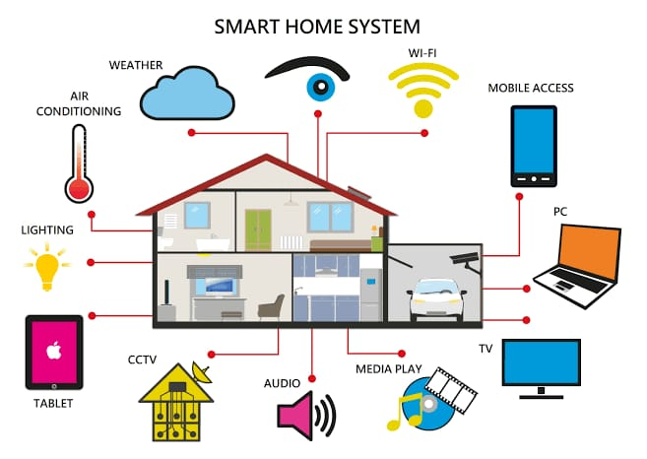
Project Name : Home Control using Logic gates
Introduction : Smart technology changes how we do things without needing constant human help, improving industries and daily life. Home Automation uses tech to make homes more efficient, secure, and personalized, saving energy and making life easier.

Slide 4
Objectives
1. Develop a motion detection system using PIR sensor which trigger an output when motion is detected
2. Design a Darkness detection circuit using LDR to get some counter output when darkness exceeds a predefined threshold
3. Create a fan control circuit using a temperature sensor for implementing logic to activate the fan when the temperature rises above a set point and deactivate it when it falls below.
4. Interconnecting those three circuits to work harmoniously within the smart home system

Slide 5
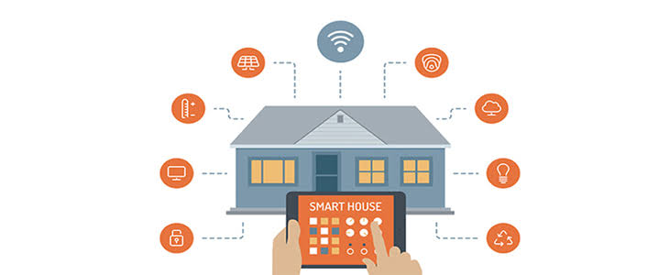

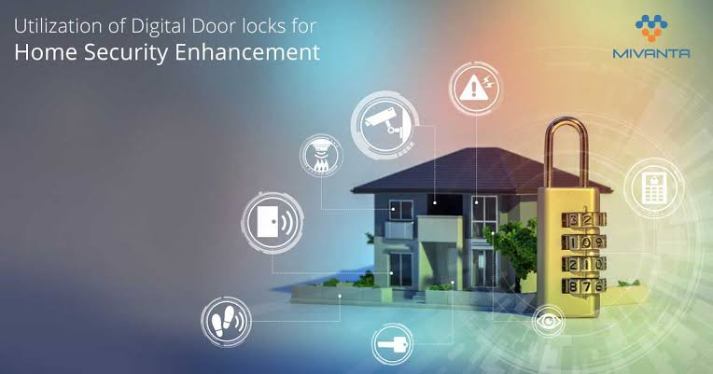
Why we choosed Home Automation
Lifestyle Enhancement: Home automation has the potential to significantly improve the quality of life by making daily routines more streamlined and convenient. From controlling lighting and temperature to managing appliances, automation adds ease and comfort to our daily lives.
Energy Efficiency and Sustainability: In a world increasingly focused on sustainability, home automation offers a platform to optimize energy usage. Smart systems can regulate energy consumption, reduce wastage, and contribute to a greener and more sustainable lifestyle.
Security and Safety Enhancement: Home automation systems provide advanced security features, such as smart surveillance, remote monitoring, and automated alarm systems. Implementing these features not only enhances safety but also provides peace of mind to homeowners.

Slide 6
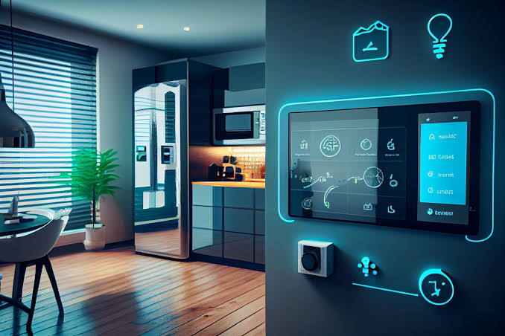
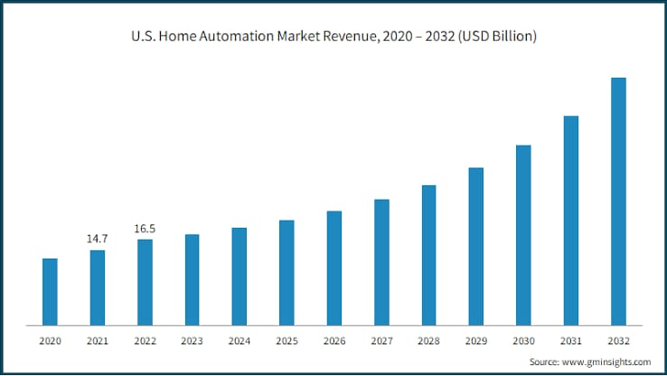

Customization and Personalization: Home automation lets us tailor our living spaces to our preferences. Through programmable settings and personalization options, we can create environments that suit individual needs and preferences, making each home unique to its inhabitants.
Market Demand and Future Prospects: The growing market demand for smart homes and the increasing adoption of home automation technology underscore its relevance and potential. Exploring this field opens up opportunities for future careers and entrepreneurial ventures.
Interdisciplinary Collaboration: Home automation projects often involve collaboration between various disciplines like engineering, computer science, design, and environmental studies. This project provides a platform for interdisciplinary collaboration, fostering a holistic approach to problem-solving

Slide 7
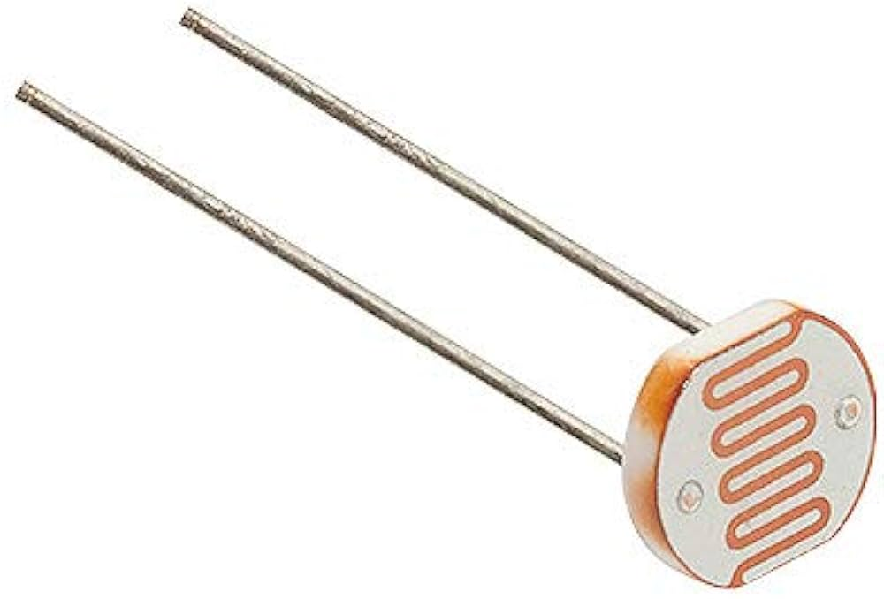
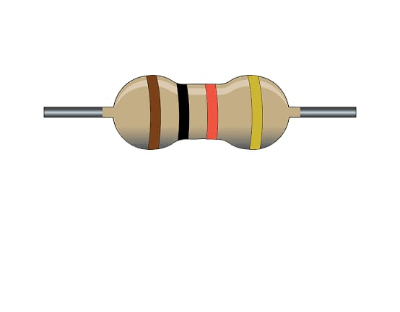
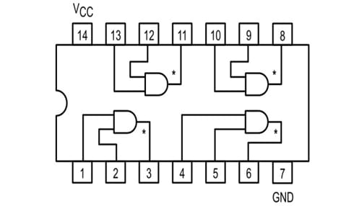
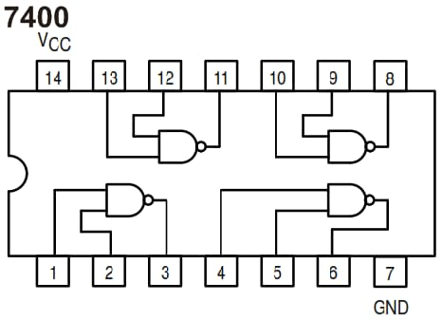
Required Equipments
Equipments Name
LED
Resisitor ( 500Ω,330Ω,1kΩ,220Ω)
Photoresisitor
AND gate(7408)
NAND gate (7400)
Resistor
Photoresistor
AND gate (7408)
NAND gate (7400)

Slide 8
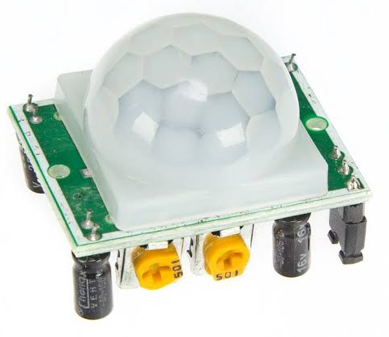
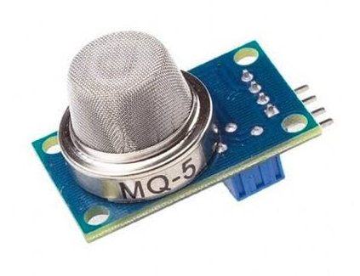

Equipment Name
Breadboard
Battery(9V)
MQ5 Gas Sensor
PIR Motion Sensor
Switch
Connecting wires
MQ5 Gas Sensor
PIR Motion Sensor
Battery(9V)

Slide 9
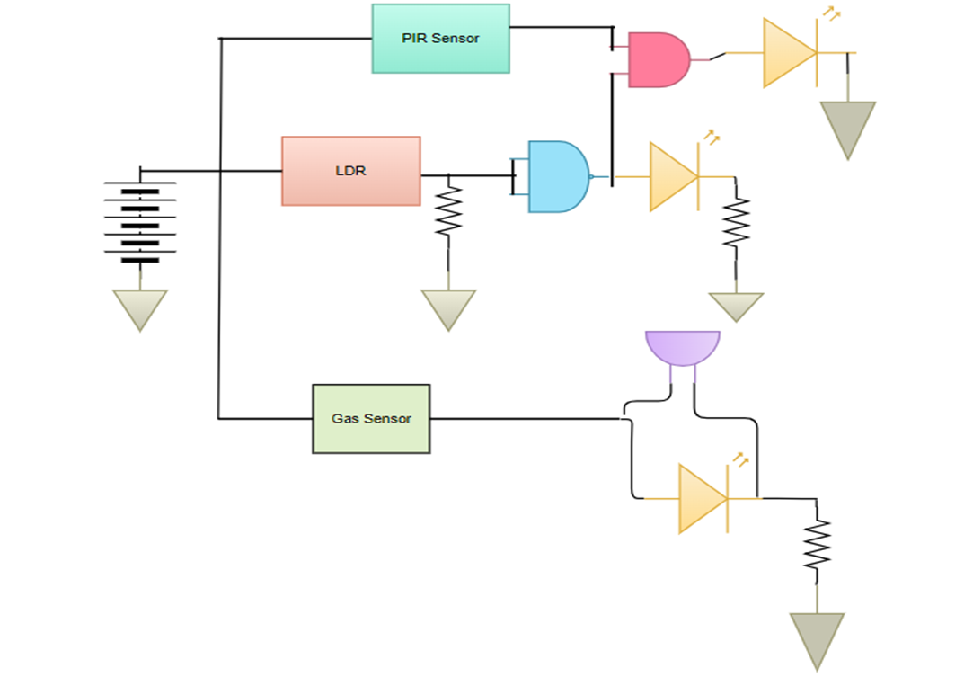
Circuit Diagram
9

Slide 10
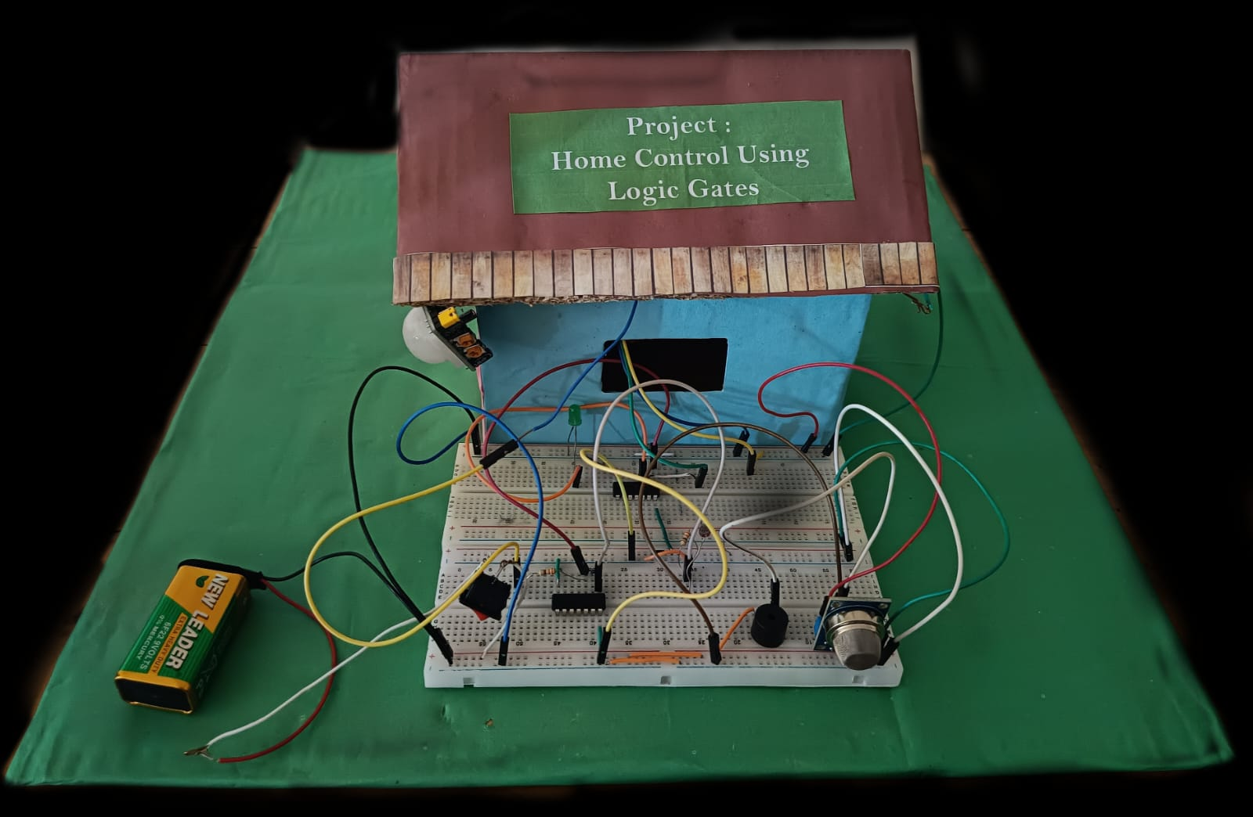
Practical circuit :

Slide 11
Methodology :
The smart home system crafted through the utilization of logic gates encompasses three primary functions. It includes a Motion-Detected Light circuit that triggers an LED upon motion detection, a Gas Detection Alarm circuit that activates a Buzzer when gas is sensed, and a Darkness Detector Light circuit wherein an LED adjusts according to ambient light levels. These circuits, powered by a DC supply, work synergistically to elevate both home automation and energy efficiency, fostering a more streamlined and adaptive living environment that promptly responds to varying conditions.

Slide 12
Application
Energy Efficiency:
By automatically controlling lighting, energy can be saved by ensuring lights are only on when needed.
Cost savings:
We are reducing the energy consumption with the project. Reduced energy usage leads to lower utility bills.
Comfort and convenience :
When Lights and Fans are being controlled automatically, it saves our effort and give us more comfort compared to controlling them manually.
Safety and Security :
In this automation system, we are using motion detection sensors. Motion detection can serve as a security feature, triggering lights or alarms in response to suspicious activity. Our security can be maintained without costing much.

Slide 13
Barriers and Limitations
Initial Cost: Setting up a smart home automation system can involve an initial investment in sensors, controllers, and devices, which may not be feasible for everyone.
Complexity: Designing and implementing the system can be complex, especially if you have limited experience with electronics and programming.
Maintenance: Smart home systems require periodic maintenance and updates to ensure they continue to function correctly and securely.
False Triggers: Sensors like PIR sensors may sometimes produce false positives, triggering actions based on benign movements or changes in lighting.

Slide 14
Conclusion:
In conclusion, our little effort will fall short for a fully setup "smart home automation project". Although this project offers numerous benefits such as convenience, energy savings, and enhanced comfort, it's important to be aware of the project's limitations, including initial costs, complexity, and the need for ongoing maintenance. By understanding these limitations and addressing them effectively, we can create a smart home system, with a view to not only improving our daily life but also providing a secure and efficient living environment. We plan to work longer on this project to learn more and properly implement the system.

Slide 15
Reference:
All the images of this document are taken by searching Google images.
The links are provided below :
Smart home system – 1
Home automation – 2
Energy efficiency– 3
Security and safety -4

Slide 16
Thank you.

